Slide 1


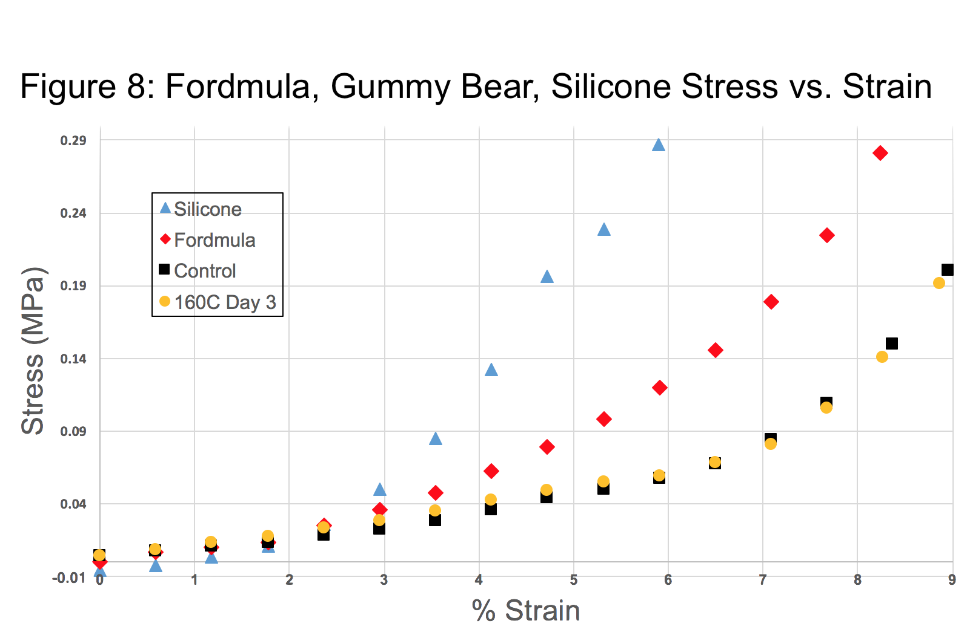
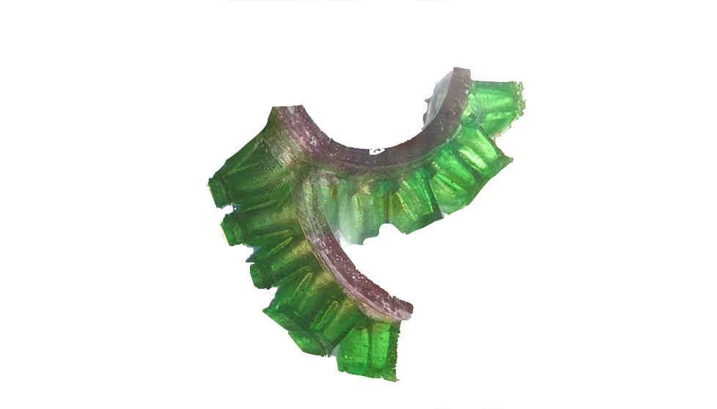
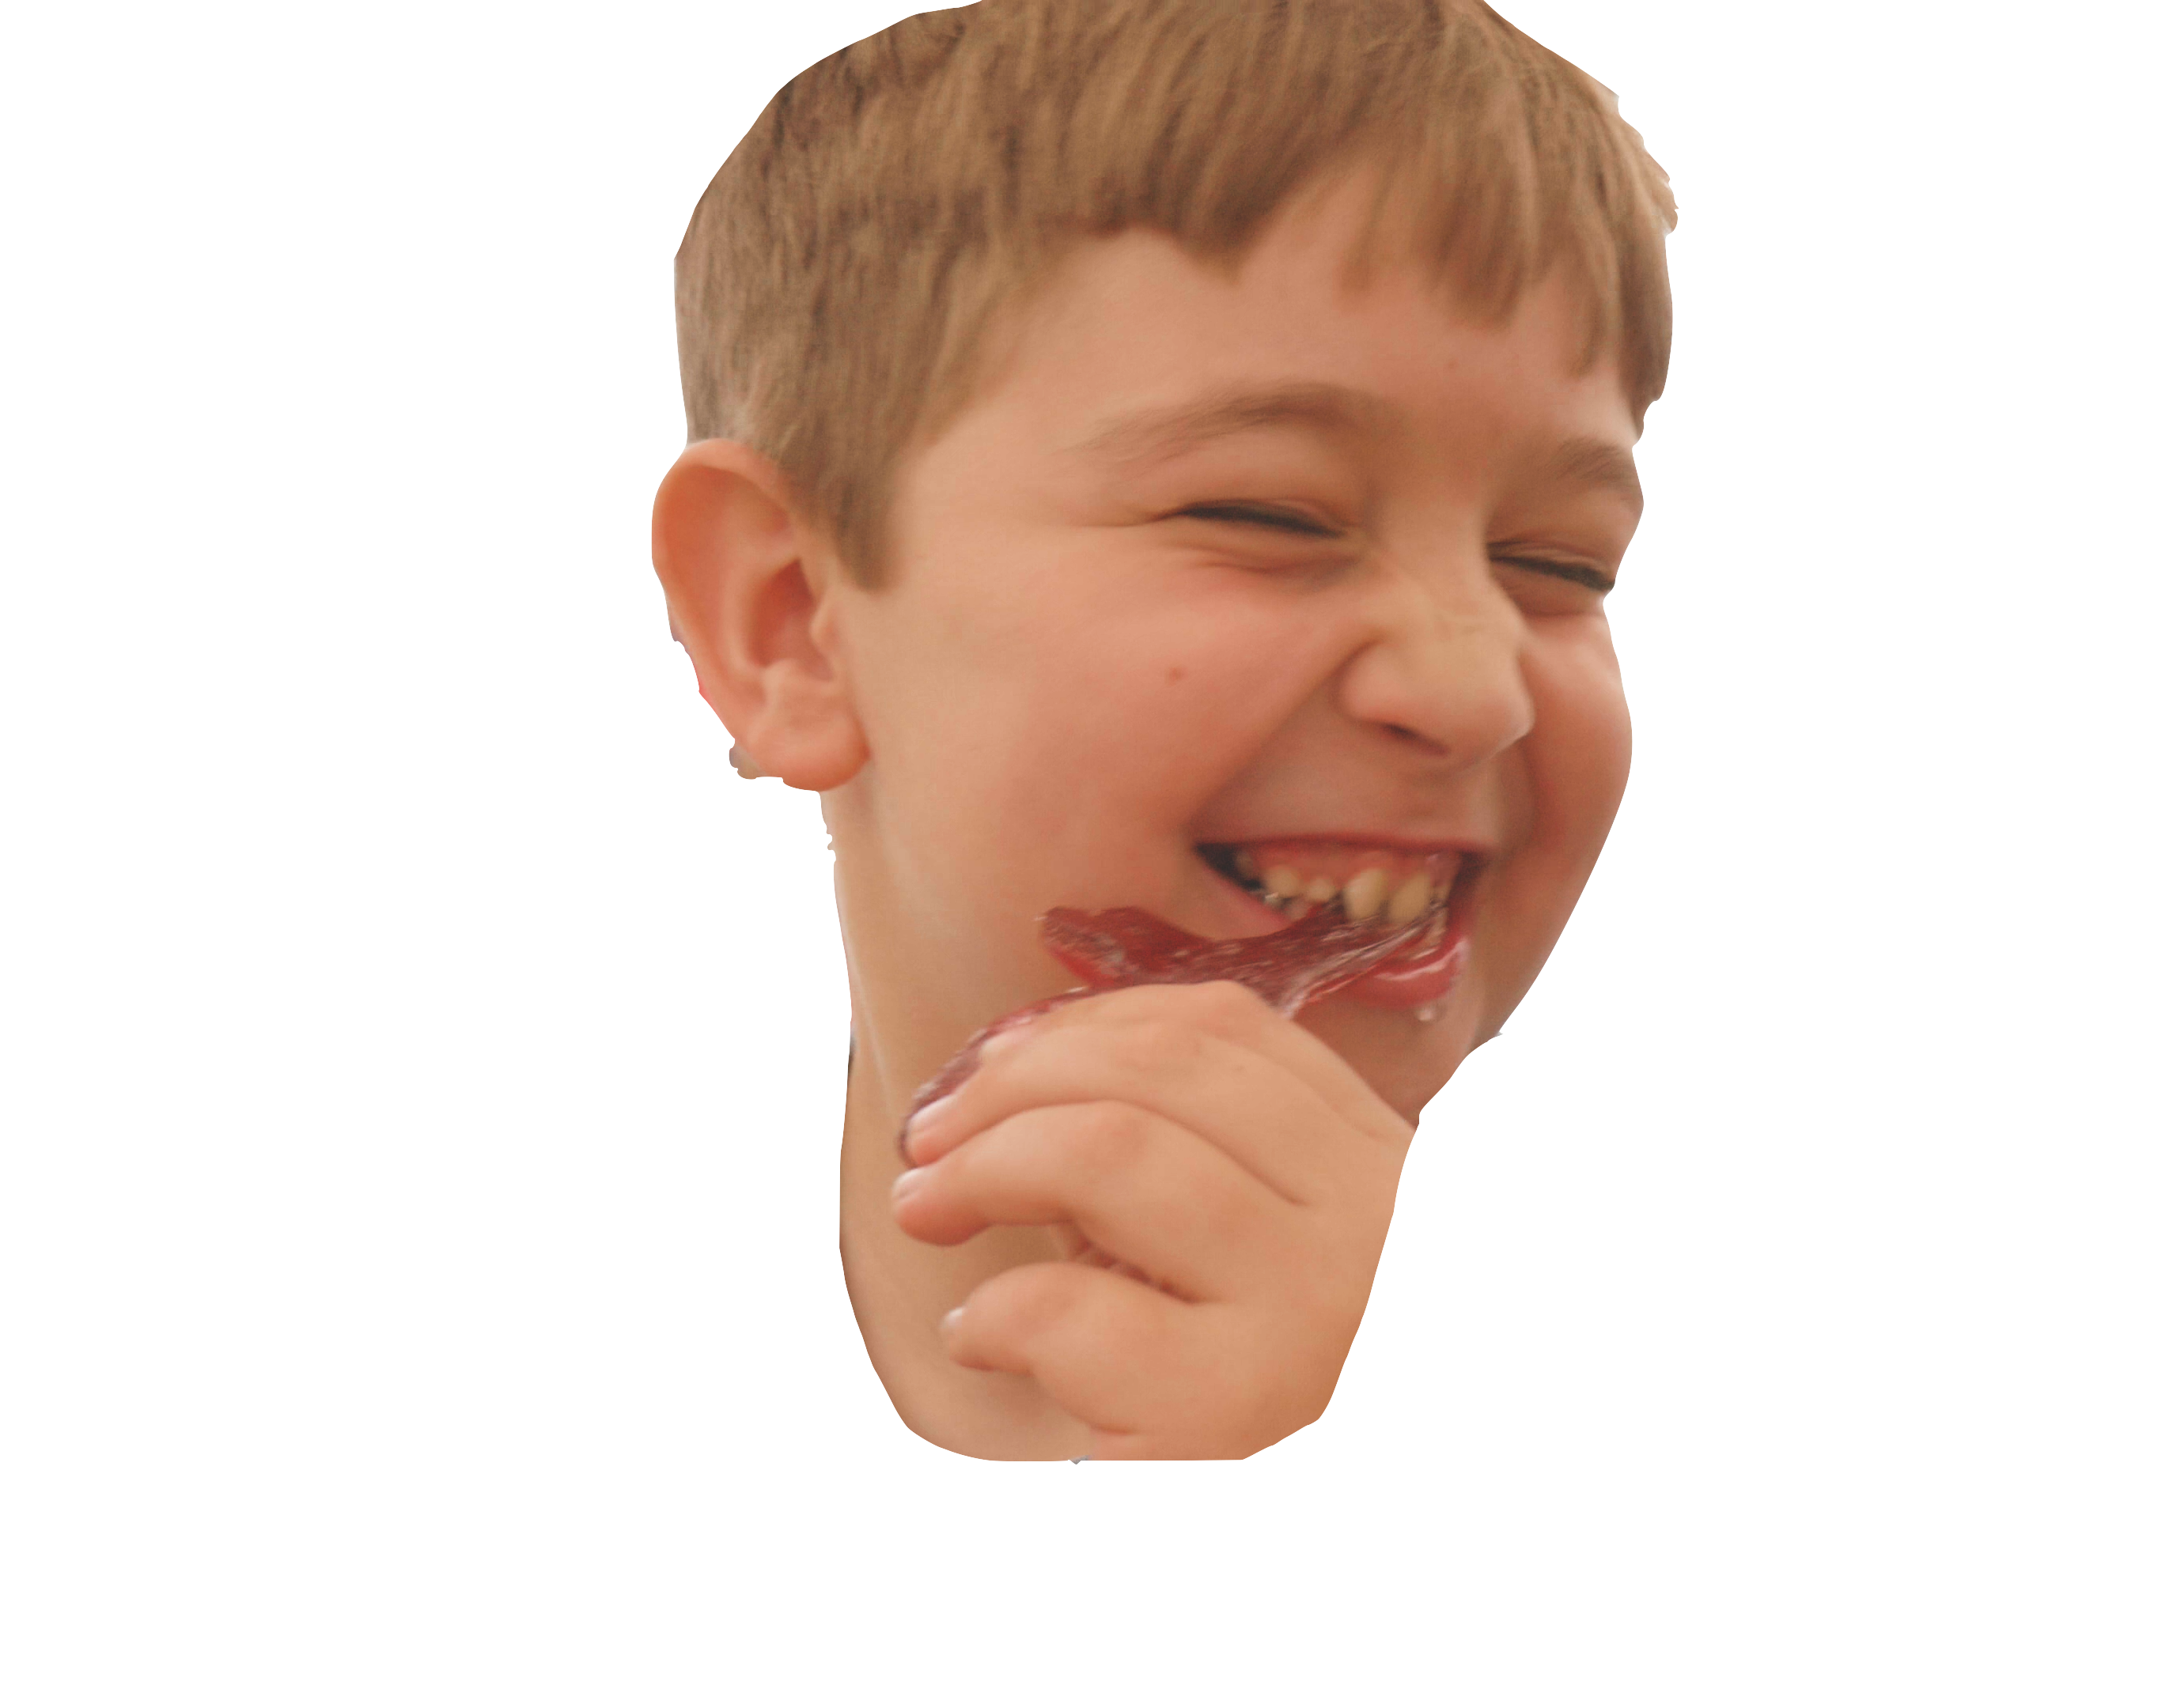
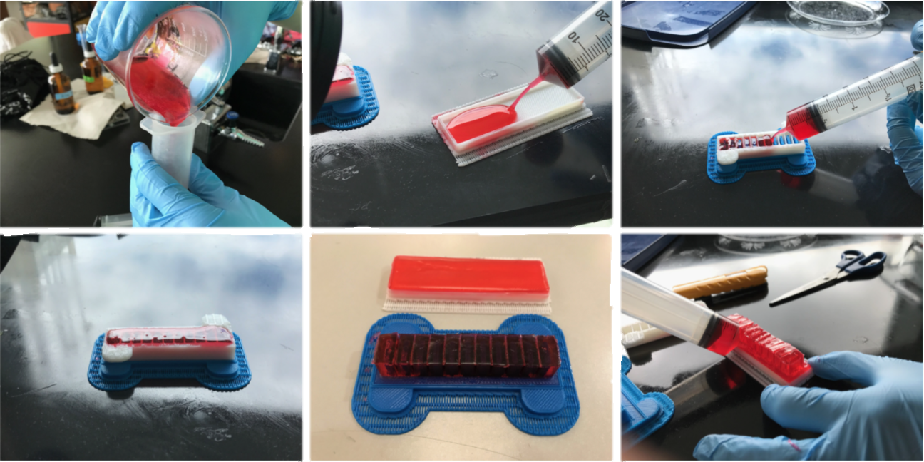
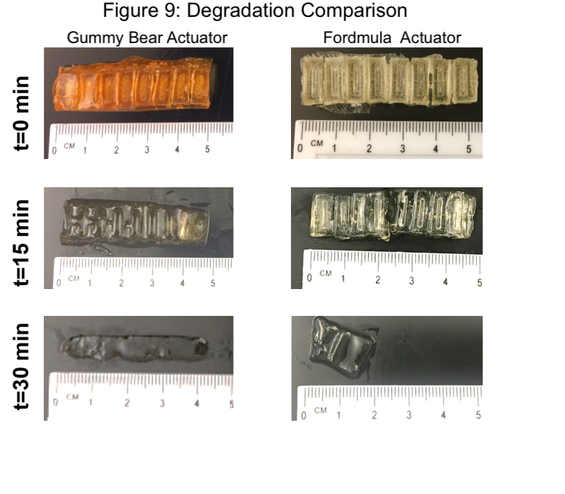
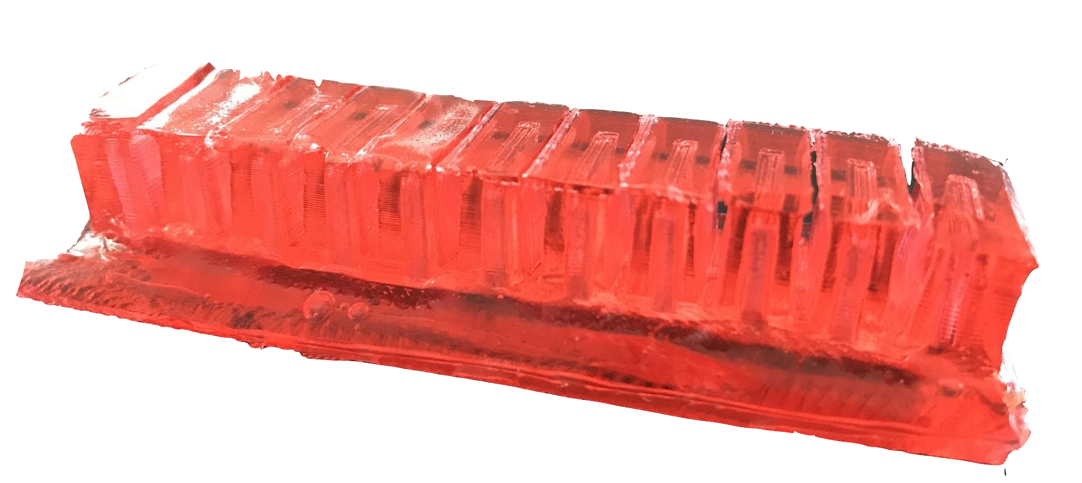

Food for Thought: An Exploration in Edible Soft Robots Xavier M. Segel, Mathew Baumholtz, Aditya Sardesai, Yiheng Chen, Richard Buonocore, Ruhao Sun, Kyle Wagner and Bram Schork
Introduction
Results
Conclusion
One goal of soft robotics is to interface robotics with the human body. Traditionally, silicone has been the dominate material in the field of soft robotics, but this material is not compatible with the body. We looked to create a biodegradable, biocompatible, and edible material. We developed novel actuators which are biodegradable, edible, and tasty. We believe the applications of biodegradable and edible actuators could be a product sold as an interactive candy for children to learn about implantable soft robotic devices, in addition to a tasty and fun delivery mechanism for medication.
The Fordmula achieves the three goals:
The moderate stiffness (refer to Figure 8) makes it actuate better than the gummy bear material yet still is easy to chew.
It is not as elastic as the silicone material and vastly outperforms other edible materials like gummy bears
The Fordmula is also proven to degredate within an emulated human body.
The Fordmula
This figure compares the elasticity of silicon actuators (blue), Fordmula actuators (red), stale gummy bear actuators (yellow) and fresh control gummy bear actuators (black).
References
These six figures demonstrate the molding process of the Formula.
J. Shintake et al. (2017) Soft pneumatic gelatin actuator for edible robotics.
PATENT HERE
We would like to express our gratitude for the Soft Robotics toolkit for allowing us to submit our work; The Haverford School for supplying us with amazing opportunities like this; Mr. Trocano for the help, guidance, and advice during this project and for letting us use the Chemisty lab; Dr. Li for helping us file a provisional patent. But it is our greatest pleasure to acknowledge Mrs. Golecki for her guidance, support, and motivation through this whole process.
We wanted to create an actuator with three properties:
Ability to actuate numerous times
Ability to be eaten (not uncomfortably chewy)
Ability to degredate in the human body
This meant we had to test two properties, elasticity and degradation. Moderate elasticity would be vital so it could consistently actuate yet still not be difficult to chew. And degredation is vital because we want this product to be edible.
This figure compares the rate of degradation for Fordmula actuators and gummy bear actuators in a saline solution, emulating the human body. Note: silicon was not tested as it does not degrade.

